Slide 1
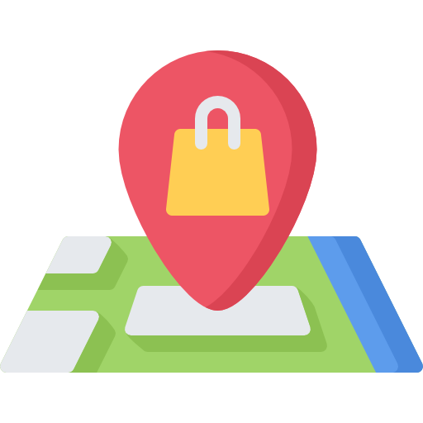
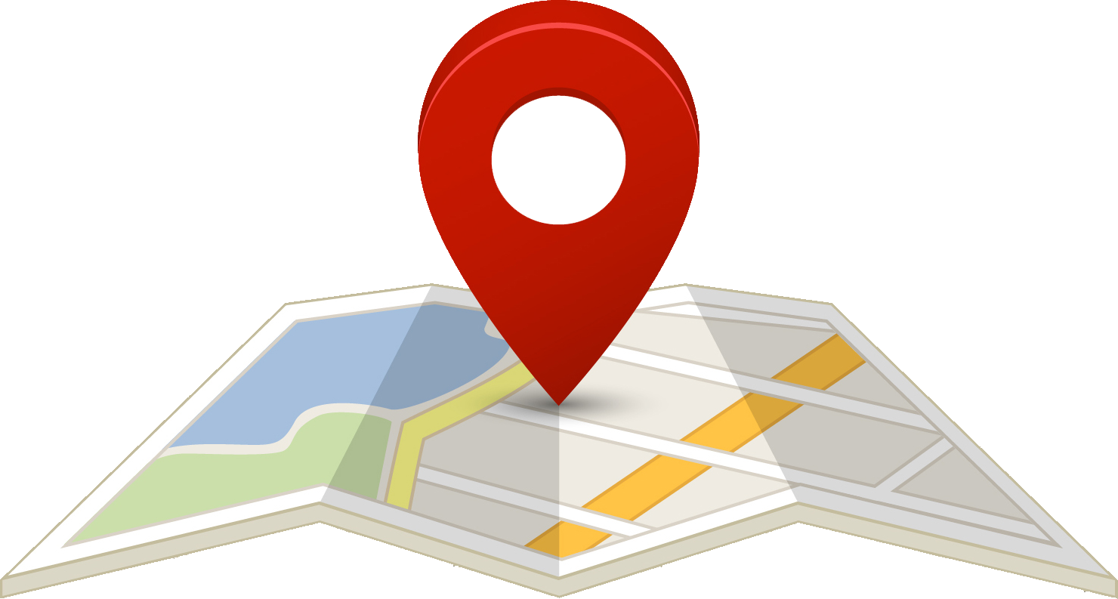
Privacy Network
A Privacy-Preserving Efficient Location-Sharing Scheme for Mobile Online Social Network Applications

Slide 2
Privacy Network
Supervisor :- Dr. Munmun Bhattacharya
Group No. 16
Anumoy Nandy (00201100121)
Kunal Pramanick (302111001005)
Manas Pratim Biswas (002011001025)

Slide 3


Introduction

Slide 4
Mobile Online Social Networks (mOSNs)
Shift from traditional online social networks (OSNs) to mobile OSNs due to advancements in mobile internet technology
Users keep mobile devices online, enabling location-based services like friend location queries and Point of Interest (PoI) searches

Slide 5
Unique Features of mOSNs
Leverage mobile communication networks and social networks for dynamic interactions
Enhancements include location-awareness, tag media, and real-time web support
Utilize modern mobile device capabilities: GPS, sensing modules, and multiple radios

Slide 6
Security Challenges in Location Sharing
Vulnerabilities in existing schemes exposed to attacks like denial-of-service, replay, and insider attacks
Advanced attacking techniques include Regional Statistical Attack (RSA) and Long-term Statistical Attack (LSA)

Slide 7
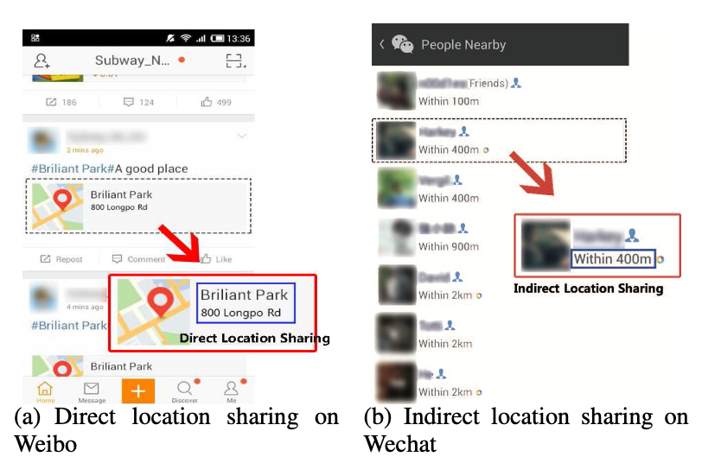
https://ieeexplore.ieee.org/abstract/document/7556276/

Slide 8
Need for a secured, privacy-preserving location sharing strategy
Solution
Privacy Network

Slide 9
Why Privacy Network?
Direct and Indirect Location Sharing Risks
Attackers can infer user demographics from shared location profiles
Proposed scheme introduces end-to-end encryption for location updates and friend's location queries

Slide 10
Why Privacy Network?
Intentional Location Spoofing
Privileged insiders can use apps like FakeGPS to provide fake locations
PrivacyNetwork addresses this issue through session key encryption
https://www.mobigyaan.com/how-to-fake-your-location-on-facebook-whatsapp-and-snapchat-guide

Slide 11
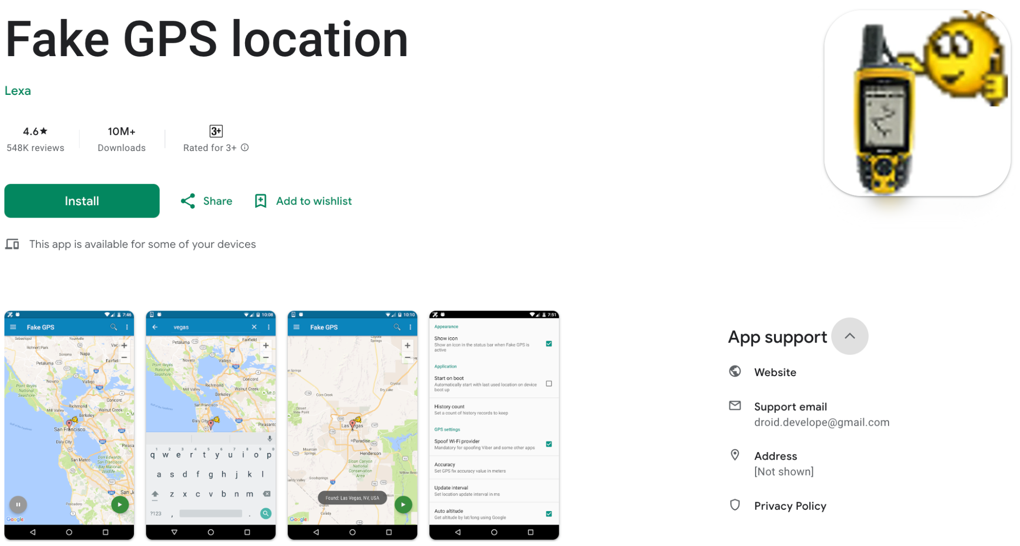
https://play.google.com/store/apps/details?id=com.lexa.fakegps

Slide 12
Why Privacy Network?
Large Network Safety Concerns
Sharing location with a large number of friends may pose security hazards
PrivacyNetwork allows users to set distance thresholds for better control over location sharing

Slide 13
Why Privacy Network?
Location Privacy Risks in Current OSNs
Sharing location with a large number of friends may pose security hazards
PrivacyNetwork allows users to set distance thresholds for better control over location sharing

Slide 14
Why Privacy Network?
Location Privacy Study - H. Li et al.
Three-week real-world experiment with 30 participants revealed alarming results
Direct location sharing on OSNs exposed 16% of users' real Points of Interest (POIs)
Indirect sharing, like geolocation tags, exposed even more, reaching 33%.

Slide 15
Why Privacy Network?
Induced Privacy Attack on 22,843 mobile users - H. Li et al.
External adversaries could infer demographics (e.g., age, gender, education) from location profiles
Many social networks offer geolocation tags and check-in services
Attackers exploit these functionalities, crawling web pages to extract location information and POIs

Slide 16
Privacy Network
[1] mSON - mobile social online network
[2] LSSNS - location sharing social network server
Proposed Architecture
The Registration Phase
The mSON[1] user login, authentication and key establishment phase
The LSSNS[2] login authentication and key establishment phase
The Distance Threshold registration phase
The User location update phase
The Friend’s location query phase

Slide 17
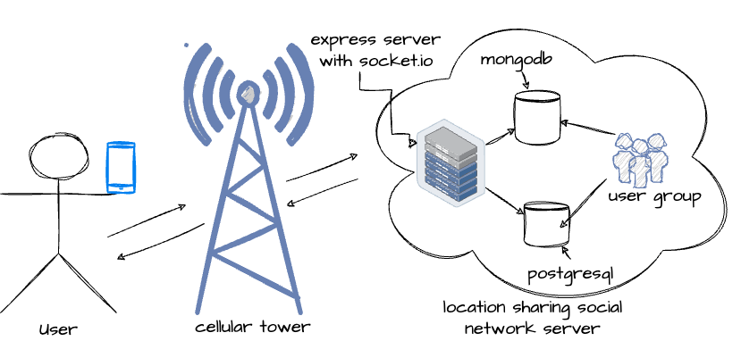
The Architecture

Slide 18
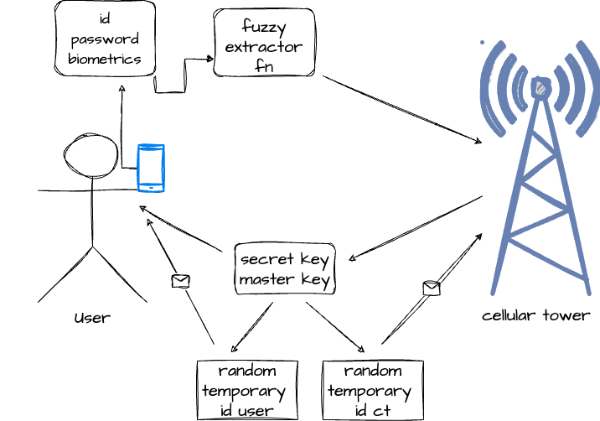
The Registration Phase - user

Slide 19
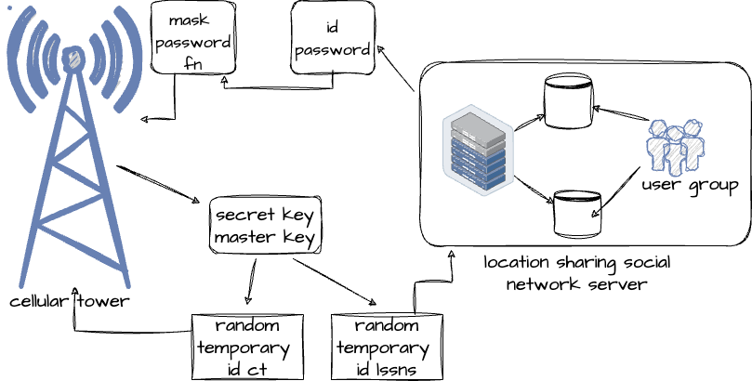
The Registration Phase - lssns

Slide 20
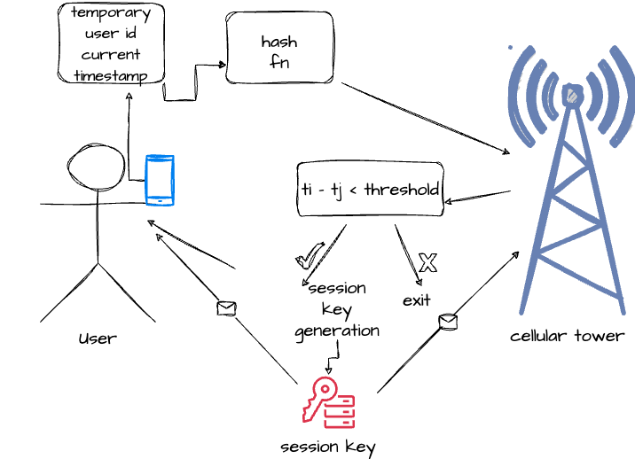
The mSON user login, authentication and key establishment phase

Slide 21
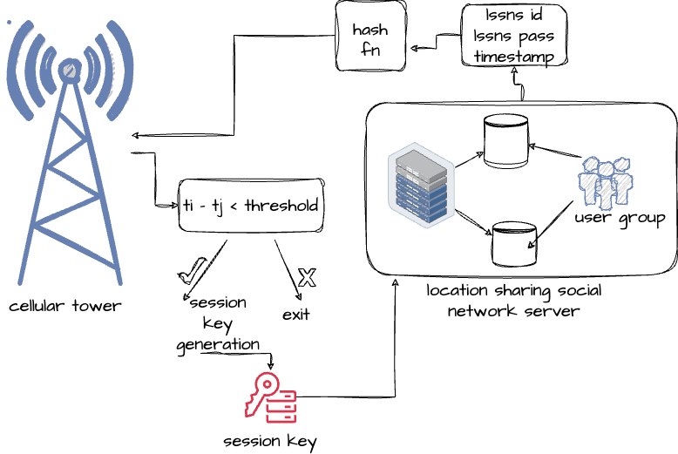
The LSSNS login authentication and key establishment phase

Slide 22
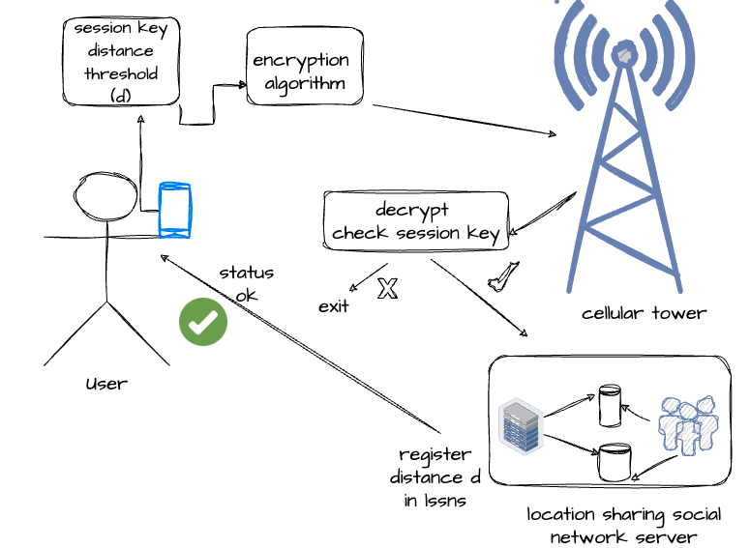
The Distance Threshold registration phase
Notes:
meet e asbo?

Slide 23
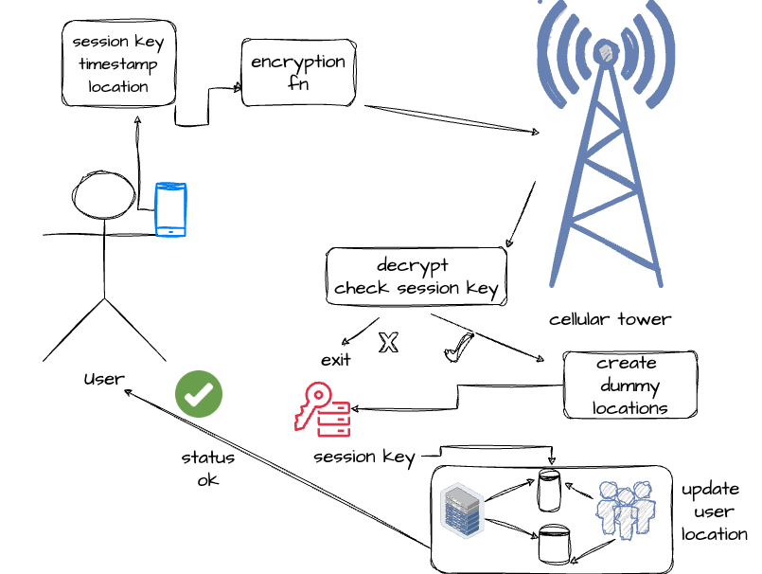
The User location update phase

Slide 24
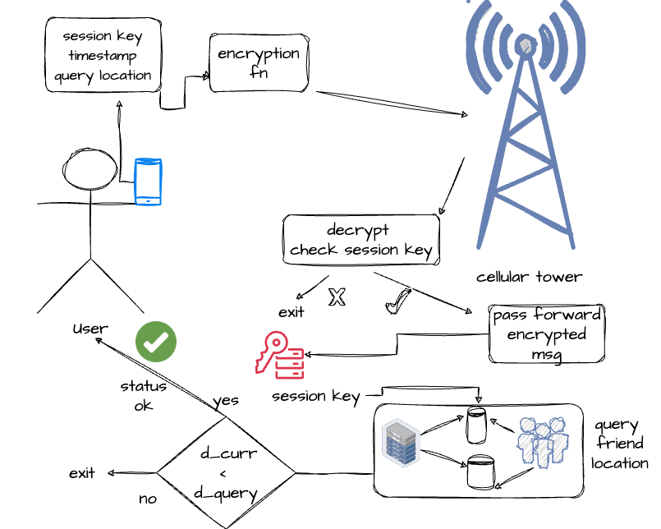
The Friend’s location query phase

Slide 25
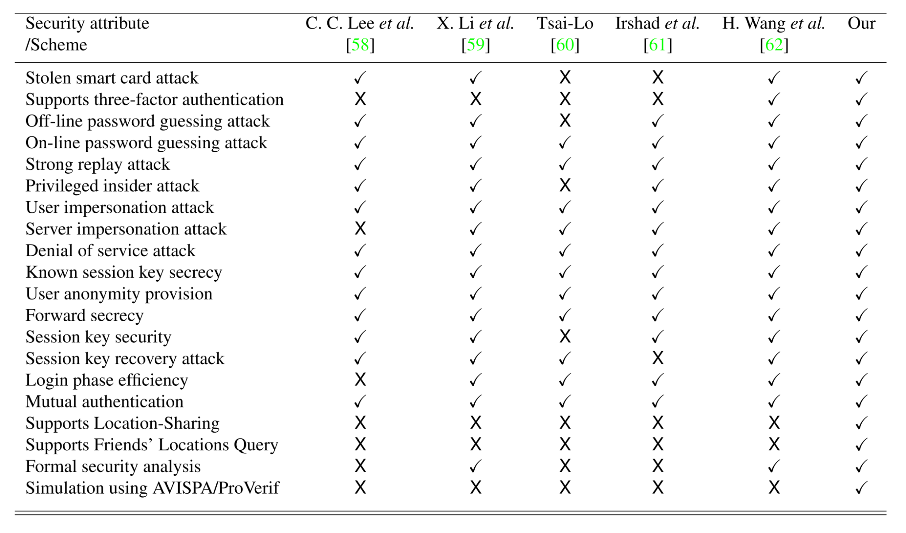
Security and Functional Comparison¹

Slide 26
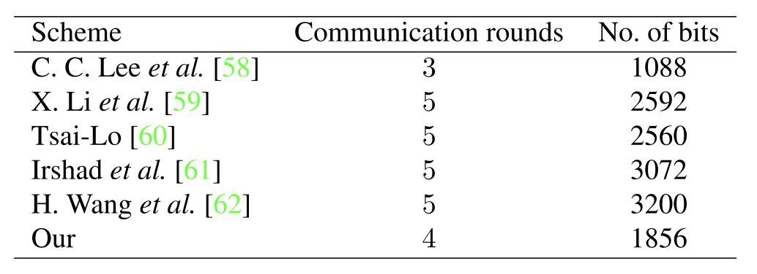
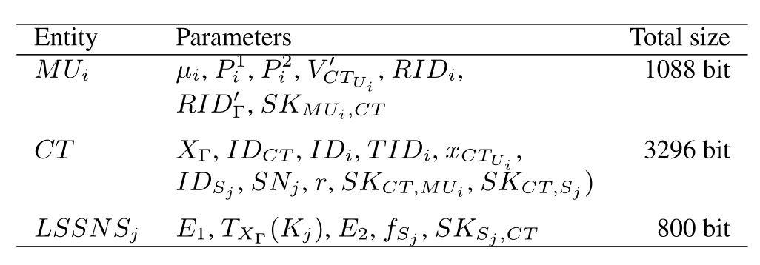
Communication Cost Comparison¹
Storage Analysis Comparison¹

Slide 27
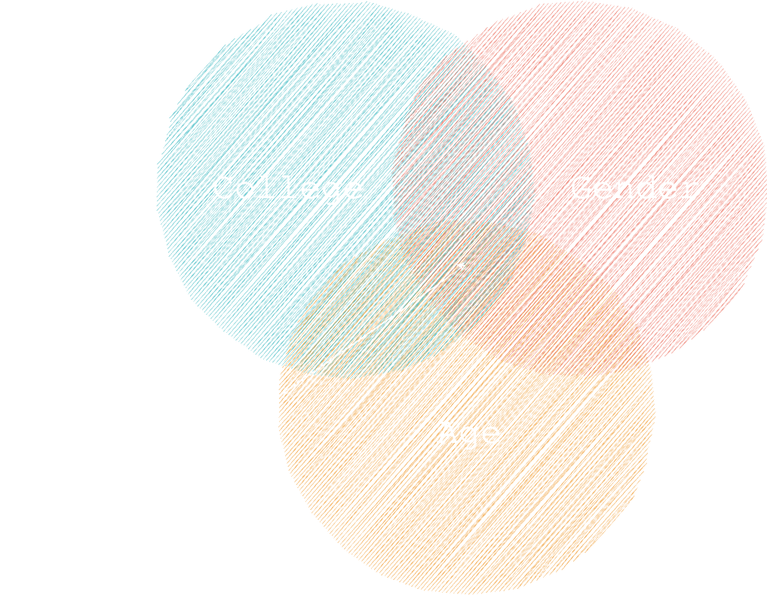
Privacy Network

Slide 28
Proof of Work

Slide 29
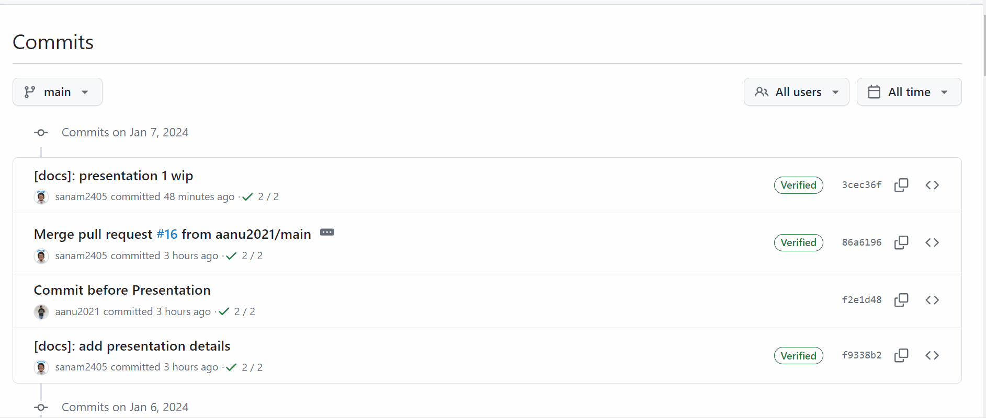
GitHub Commit History

Slide 30
A Quick Demo

Slide 31
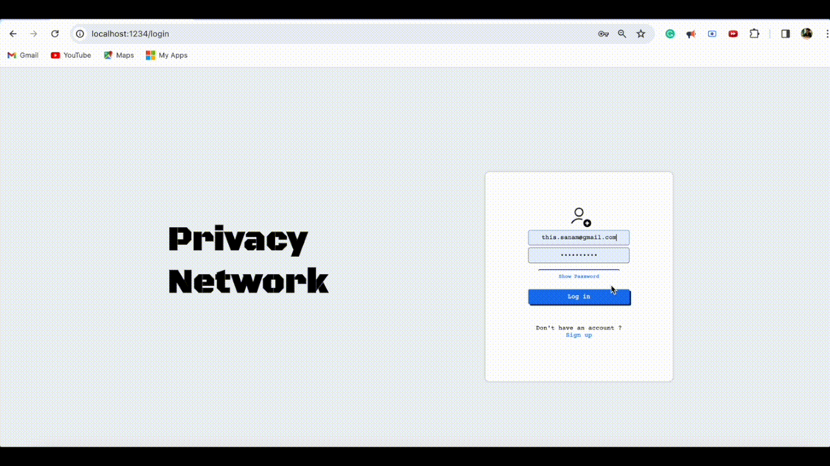

Slide 32









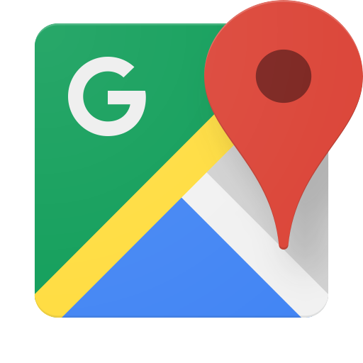
TechStack

Slide 33
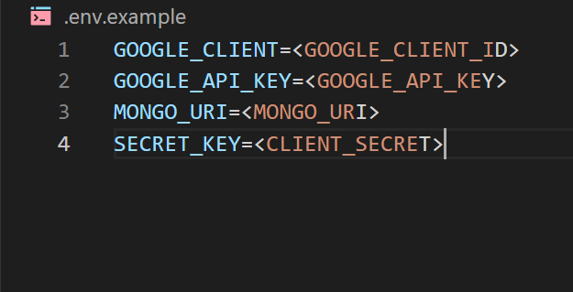
.env.example

Slide 34
Authentication

Slide 35
Authentication Metrics
- False acceptance rate
- False rejection rate
- Failure to enroll rate
- Authentication time

Slide 36
Authorization

Slide 37
Authorization Metrics
- Access control effectiveness
- Least privilege enforcement
- Policy violations
- Audit trail quality

Slide 38
Authentication & Authorization
Deep Dive
- bcrypt.js package for password hashing.
- jsonwebtoken to maintain session.
- middleware to authorize user before accessing some
component.
- @react-oauth/google package for authenticating
an users through their valid credentials.

Slide 39
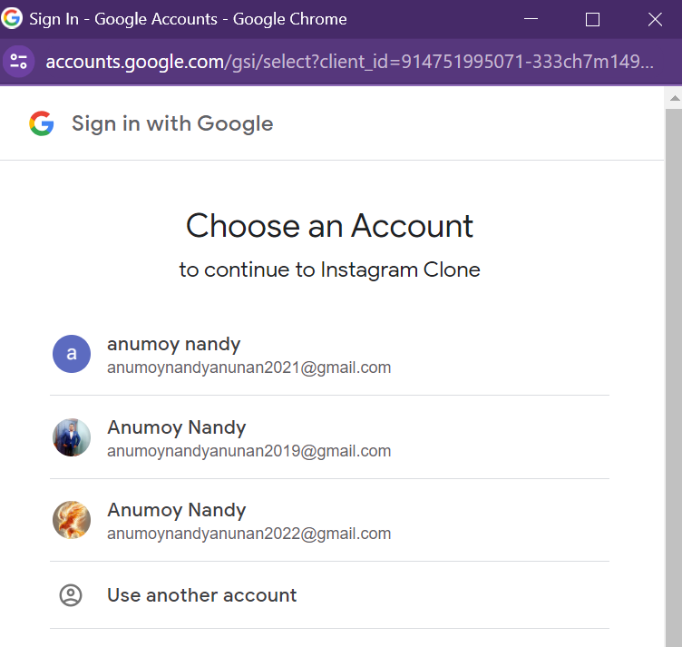
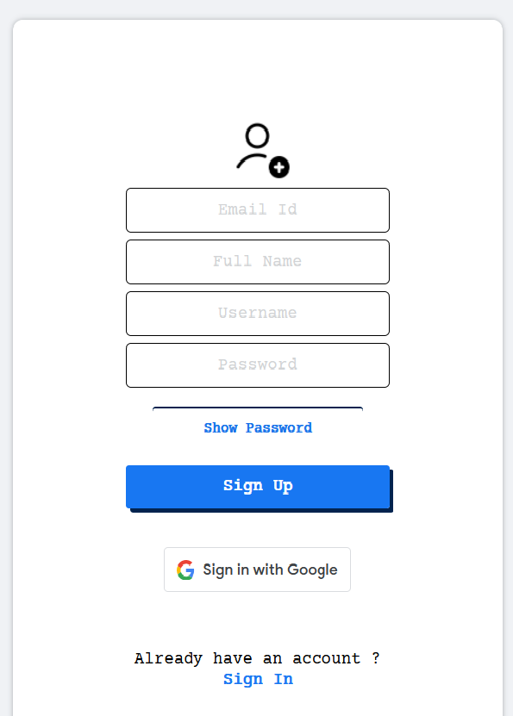
Authentication & Authorization
Deep Dive

Slide 40
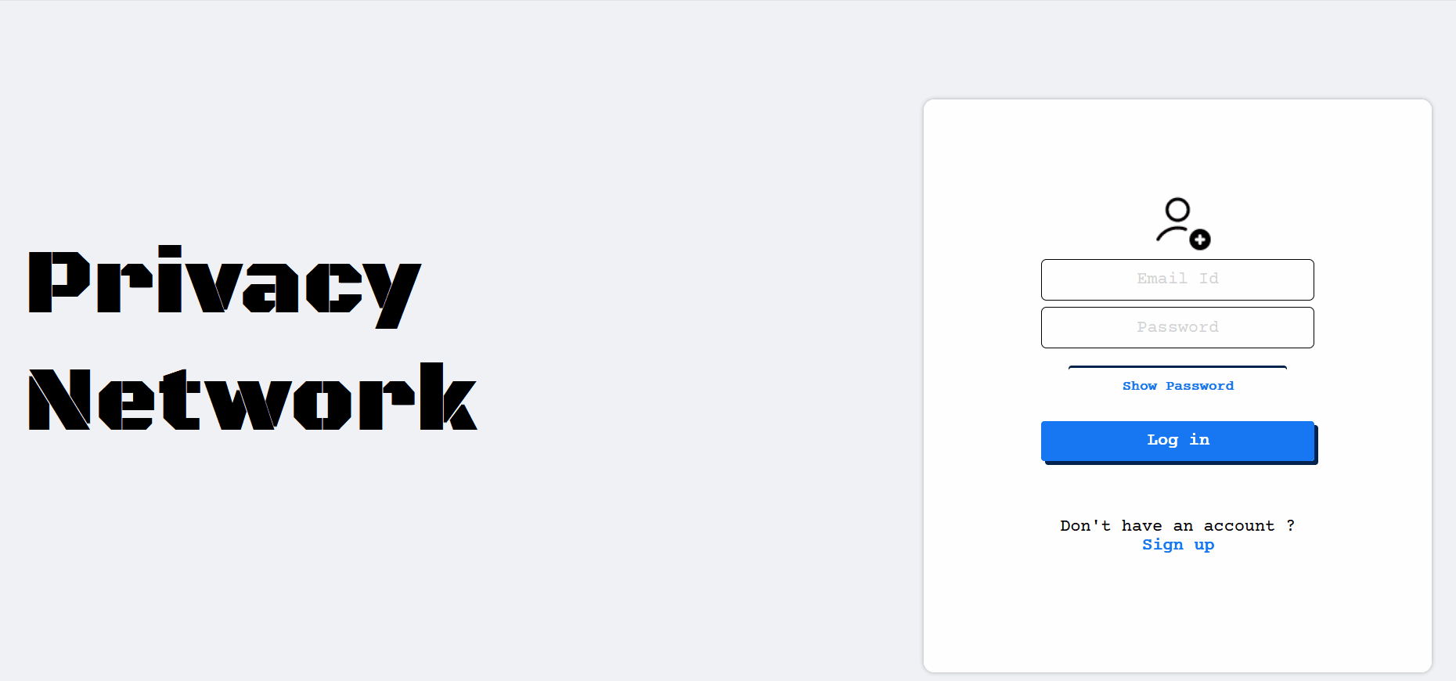
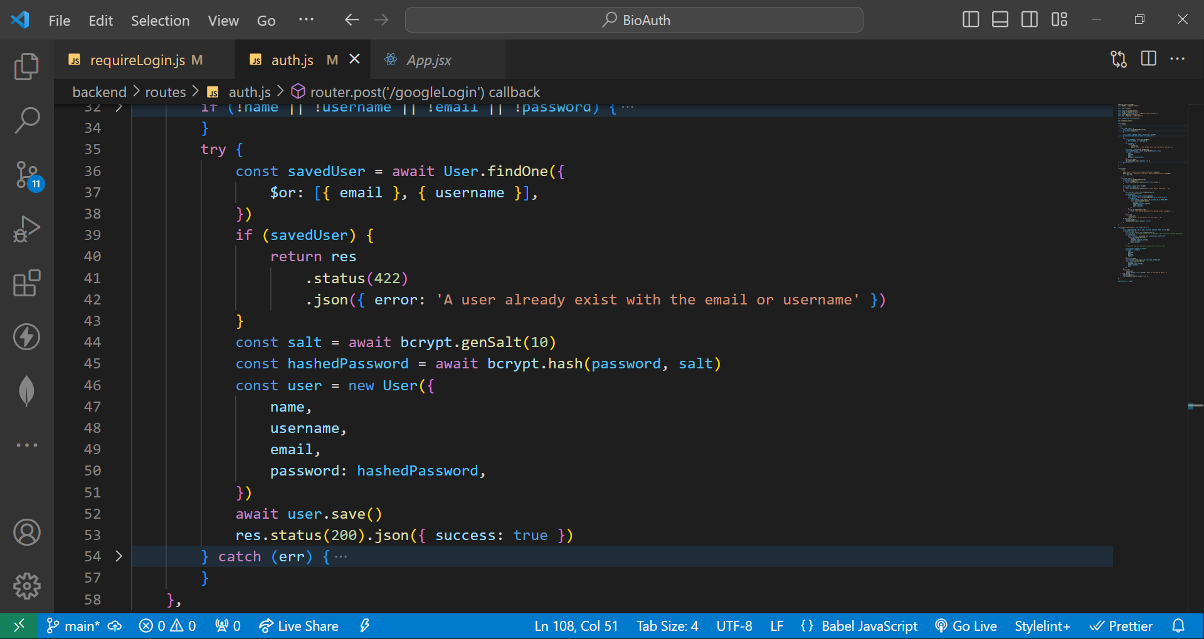

Slide 41
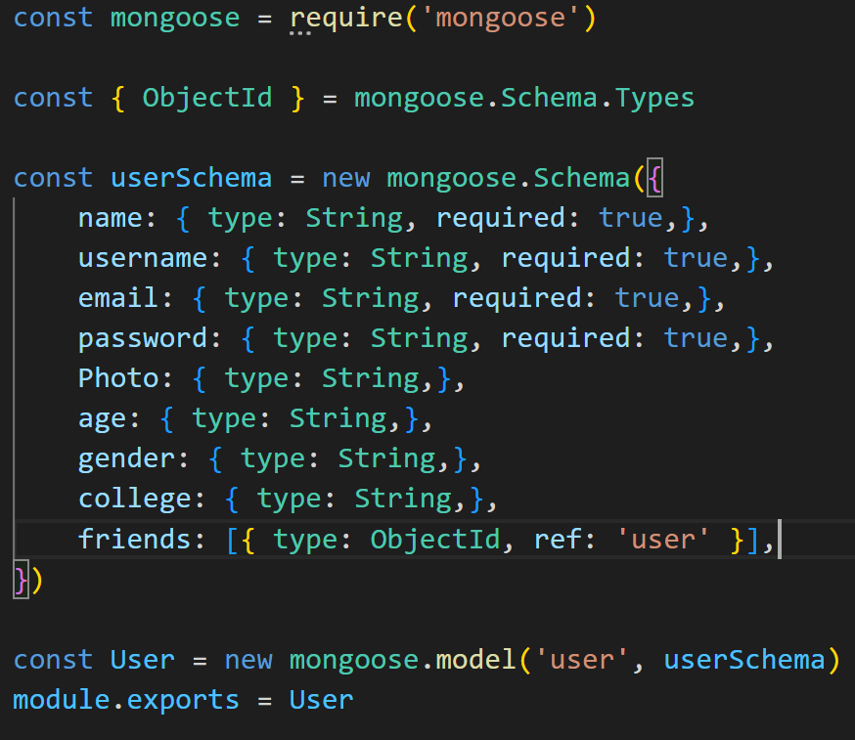
MongoDB User Schema

Slide 42
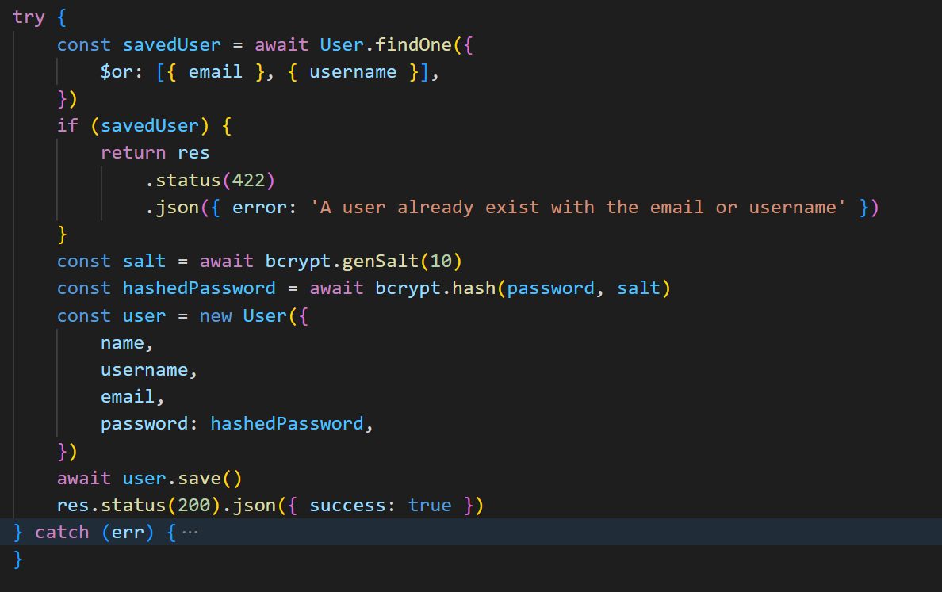
Authentication & Authorization
Deep Dive

Slide 43
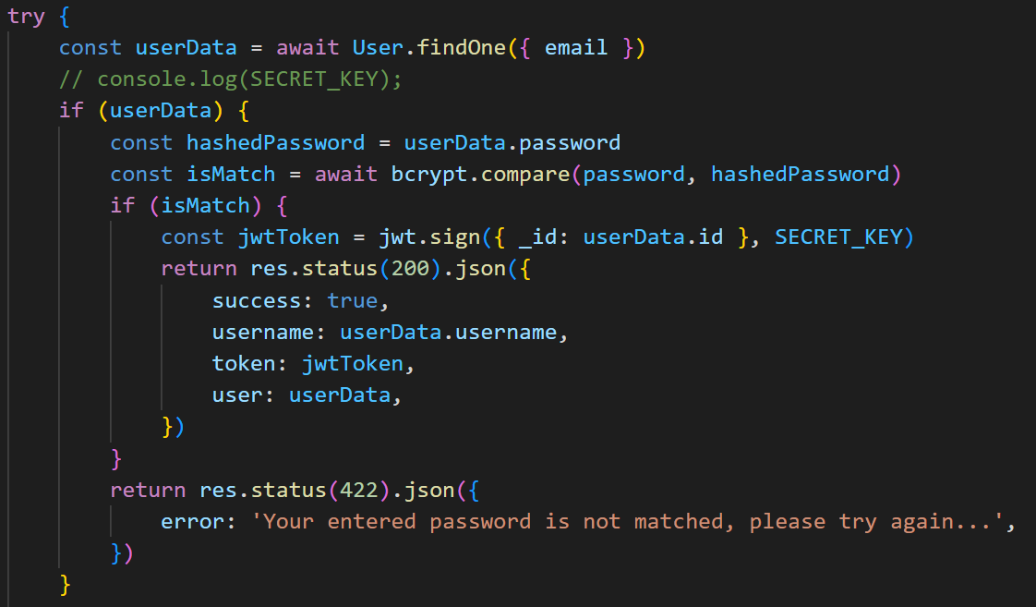
Authentication & Authorization
Deep Dive

Slide 44
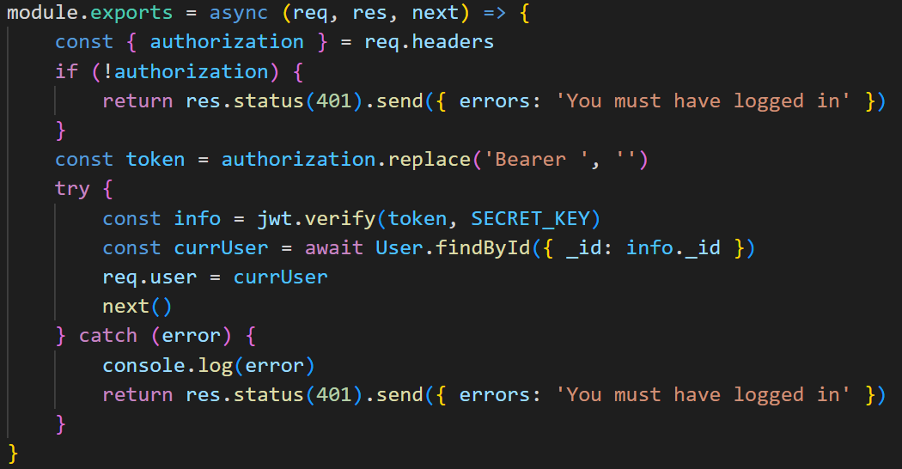
Authentication & Authorization
Deep Dive

Slide 45
Landing Page

Slide 46
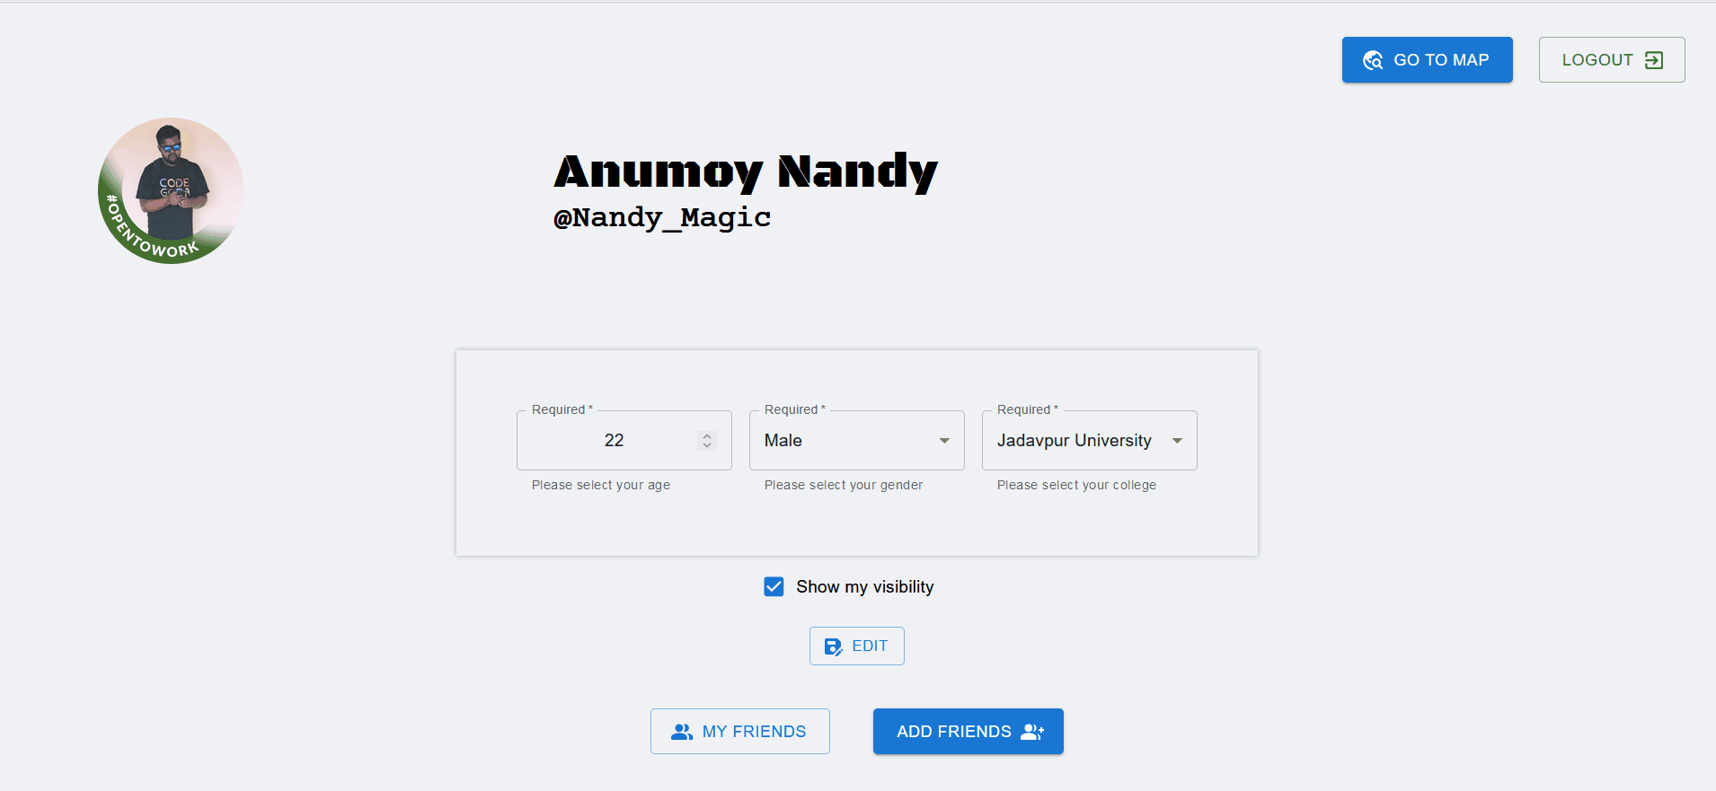

Slide 47
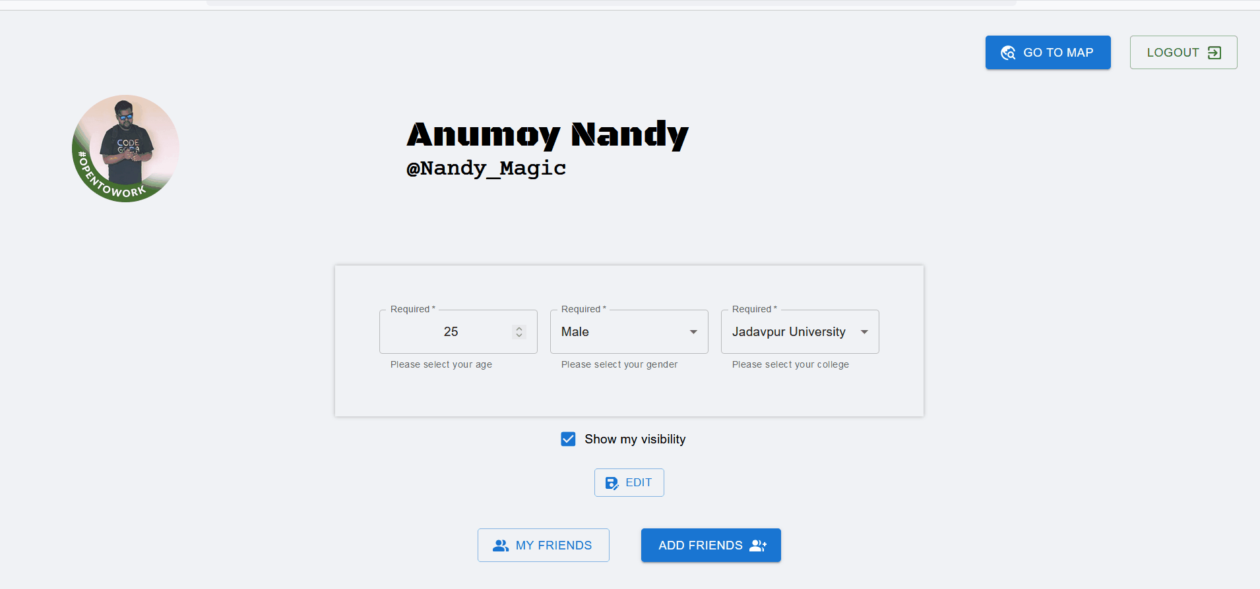

Slide 48
Location Page

Slide 49


Slide 50
Euclidean Distance

Slide 51
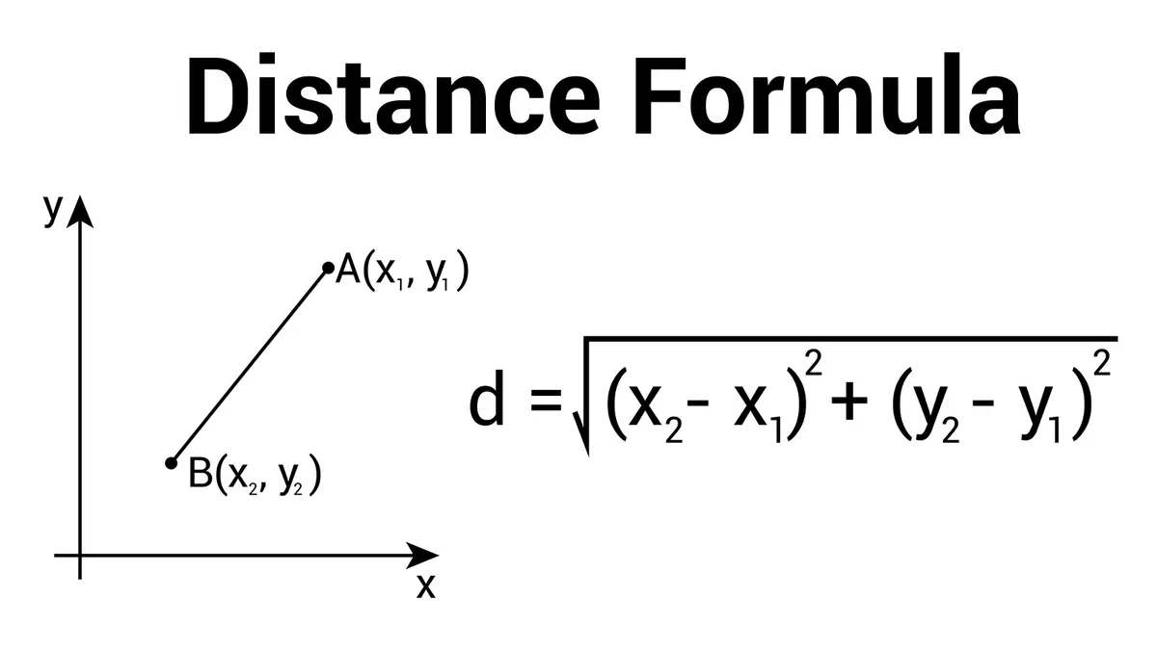

Slide 52
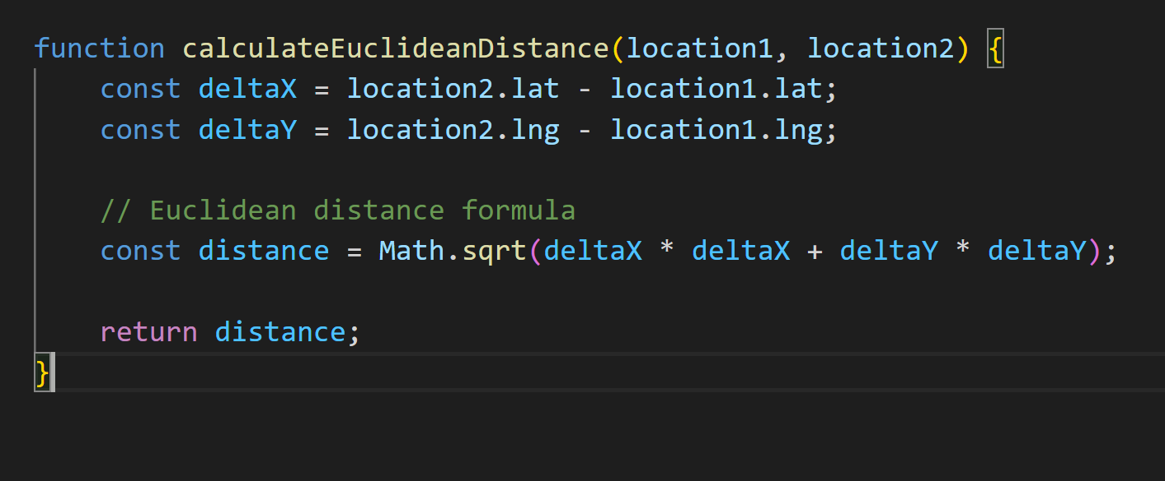

Slide 53
PostgreSQL

Slide 54
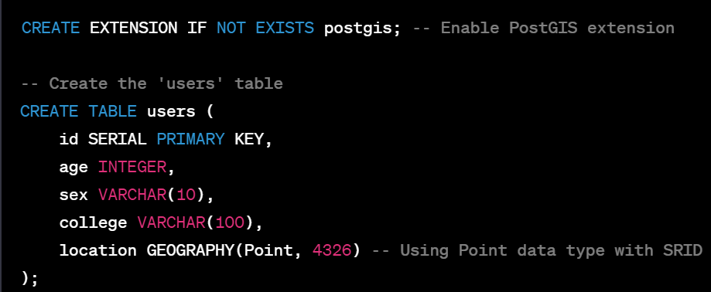
PostGIS User Schema

Slide 55
PostGIS Query

Slide 56
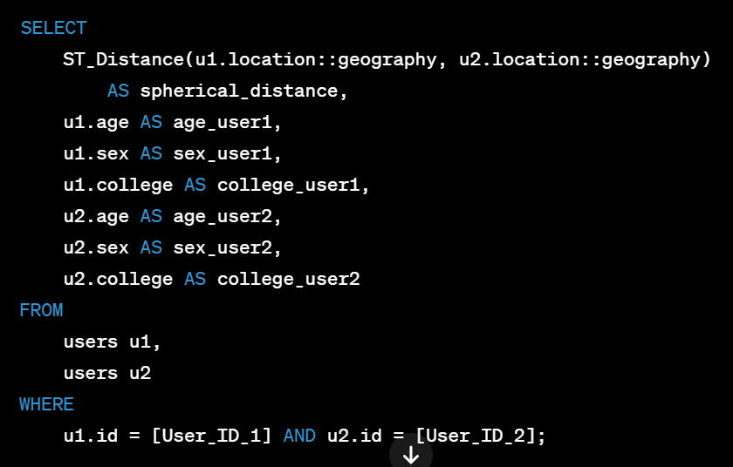

Slide 57
Conclusions

Slide 58
Conclusions
- Socket.IO & express server enables real time location sharing
- User authentication & authorization
- React keeps the data and UI layer in sync
- PostGIS queries to filter user location

Slide 59
Future Work
- Implement stranger feature
- Implement the proposed architecture in our codebase
- Deploy the web service to some cloud like AWS

Slide 60
References
A Privacy-Preserving Efficient Location-Sharing Scheme for Mobile Online Social Network Applications[1]
[https://ieeexplore.ieee.org/abstract/document/9288801]
Privacy Leakage of Location Sharing in Mobile
Social Networks: Attacks and Defense[2]
[https://ieeexplore.ieee.org/abstract/document/7556276/]

Slide 61
Thank you
https://github.com/sanam2405/PrivacyNetwork
Anumoy Nandy
Kunal Pramanick
Manas Pratim Biswas
Dept. of Information Technology
Jadavpur University

Slide 62
Questions ?

